Slide 1
Machine Learning
Pune Microsoft Azure Developers Meetup

Slide 2
Objective
What , Why , & When of machine Learning?
Types of Algorithms
Tools & Technologies.
What Azure ML has to offer?
The Data Science Process.
Demos
Demos on R .
Demos on Azure ML.
Difference b/w classification & clustering
Throwing algorithms at you .

Slide 3
What is Machine learning?
(Authur Samuel 1959). Field of study that gives computer ability to learn without being explicitly programmed.
(Tom Mitchell 1998 ). A Computer program is said to learn from experience E with respected to task T and some performance measure P , if its performance on T , as measured by P , improves with Experience E.
Notes:
Auther Samuel :- Prepared a Checkers game program for determine a optimal game position over time.
An email program watches a mail being marked as a spam or not a spam by the user .

Slide 4
An Email Program
Watches user action as he/she marks a mail as spam or not spam and then classifies the mail to the same categories.
Here
E :Watching a mail label as spam or not spam .
T: Classifying emails is spam or not spam
P: Fraction of mails correctly classified as spam or not

Slide 5
Types of Algorithms
Supervised Learning
Most Common
Right answers are already given.
Regression problem : output →Continuous value
e.g..: Given a set of House size (in sq. ft) to Price , predict the price of a house of x sq.ft.
Given a large inventory to sales history , predict how many items will be sold over the last 3 months
Classification problem : output →Discrete values
e.g.: Given a set of tumor size to Malignant or benign cancer , predict if a patient has cancer given the tumor size
e.g.: Given a set of user account and history of user activities , predict if the account is hacked or not .
Can have many dimensions.

Slide 6
Types of Algorithms
Un-Supervised Learning
Right answers are not given.
Given a dataset , determine a structure in the data set.
Clustering algorithms.
http://news.google.co.in/
Gnome problem
Social network analysis.
Customer Segmentation.
Astronomical data analysis .
Notes:
Cocktail party problem
Two people counting numbers from 1 to 10 in two different languages simultaneously . Our job is to separate the two voices from each other .
We would use clustering to solve this problem .

Slide 7
Tools & Technologies
Statistical tools
R ( http://www.r-project.org/)
Octave/MATLAB
SAS
Excel
Weka
Languages
Python: numpy/scipy/scikits-learn: http://scikit-learn.org/stable/ Orange :-http://www.ailab.si/orange/ MLPY :-https://mlpy.fbk.eu/
Java: Apache Mahout:- http://mahout.apache.org/ Weka:- http://www.cs.waikato.ac.nz/ml/w... Malet:- http://mallet.cs.umass.edu

Slide 8
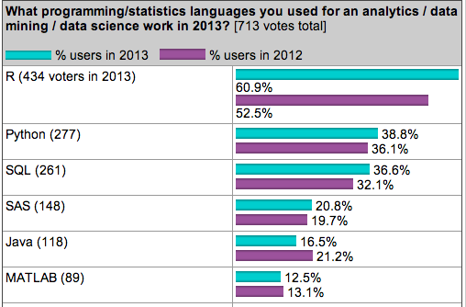
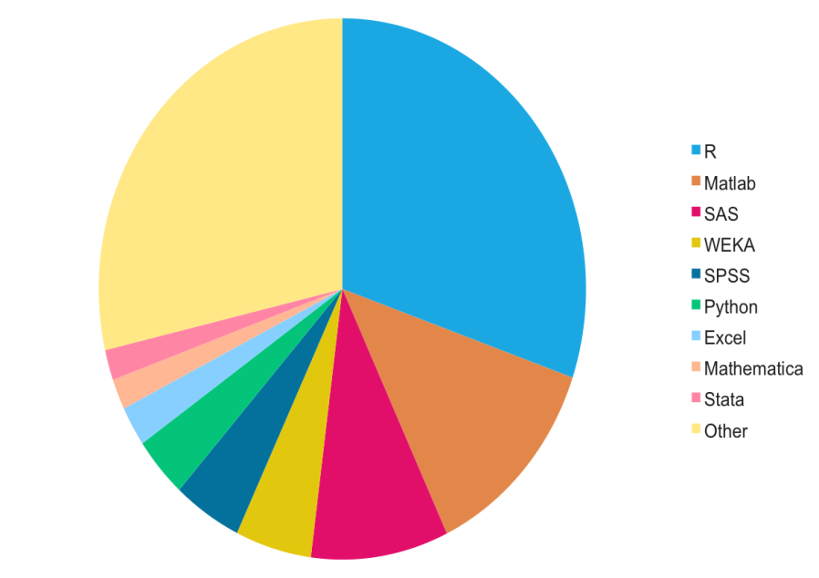
Tools & Technologies
Comparison of various languages being used in machine leaning
Reference : Machine Learning Mastery

Slide 9
What Azure ML has to offer ?
A cloud based solution to all Machine learning requirements for predictive analytics.
All major algorithms available as drag and drop components.
Built in R support
Easy to deploy
Publish your model as service.
Azure ML market place.

Slide 10
The Data Science Process
Define a business problem
Acquire & Prepare data
70-80% of work is done here.
ML applies here
Develop a Model
Train & Evaluate the model
Relearn & Reevaluate the Model
Deploy the Model

Slide 11
Acquire & Prepare Data
Database, CRM Systems, Web Log files, etc.)
Data is prepared for modelling . Data Transformation (e.g. Replace missing values, Data Normalization ,etc.
Co-relation Analytics ,Principal Component Analysis etc.
Identify the right variables
Get the data
Data is Analyzed
Determine Relationship b/w variables & Dimension Reduction

Slide 12
Demos
Demos on R .
Iris Dataset (UCI Machine Learning Repository)→K-means clustering .
Air quality (R dataset) → Liner & multiple Regression .
Demos on Azure ML.
News Recommendation System → K-means clustering .
Linear Regression → Liner Regression .

Slide 13
News Recommendation System
Problem Statement : Similar as google news.
Fetch data from various news sites via RSS feeds , and try to group the news item and suggest recommended posts for each news articles .
http://rssnewsfeeds.azurewebsites.net/
The meet up is about Azure , isn’t it ?
Uses Azure Mobile Service for API & Web job support
Uses Azure Table Storage for Data storage
Uses Azure Machine learning to suggest recommended post.
Uses Azure websites for the HTML client .

Slide 14
Architecture
News Websites / Blog posts , etc.
Azure Mobile Services
Azure Machine Learning
RSS Feeds
Job
Html Client
API
Azure Table

Slide 15
Azure ML
Feature Hashing.
Principal Component analysis.
K-means Clustering.

Slide 16
Difference b/w Classification & Clustering.
Classification :
Supervised learning
Used to define pre-defined tag to the instance on basis of features
Required to train data
Classify new instances
Clustering :
Unsupervised learning
Used to group similar instances on basis of some features
No data training required
No predefined label to each & every group.

Slide 17
Throwing algorithms at you!!!
Just visit Wikipedia .
Classification
Clustering
Regression
Simulation
Content Analysis
Recommendation Systems

Slide 18
Classification
Clustering
Content Analysis
Binary Classification
Logistic Regression
Neural Networks
Decision Trees
Boosted Decision trees
K-means
Self organizing Maps
Adaptive Resonance theory
Text mining
Natural Language
processing
Pattern Recognition
Neural Networks
Regression
Simulation
Recommendation Systems
Gradient Descent
Linear Regression
Neural Networks
Decision Trees
Boosted Decision trees
Markov Chain Analysis
Linear Programming
Monte Carlo simulation
Collaborative filtering
Market basket Analysis
Naïve Bayes
Microsoft Association Rules

Slide 19
Reference & Resources
Machine Learning By Andrew Ng : Video Lectures
Important Links
http://machinelearningmastery.com/
https://www.kaggle.com/

Slide 20
Thank You …

